Slide 1
Open Professional Learning
OSPI OER Webinar Series
February 5, 2014
with Karen Fasimpaur

Slide 2
Agenda
1. Introductions
2. What is “open”?
3. Learning about OER
4. Open-licensed PD resources
5. Q&A

Slide 3

What is “open”?
Open educational resources (OER) =
resources that can be remixed, modified, and redistributed by anyone

Slide 4
Open practice
Collaboration
Transparency
Inclusiveness
Sharing
Self-direction

Slide 5



Open professional learning
Learning about open
Learning with open content
Learning in open spaces and sharing our practices
MOOCs

Slide 6




Learning about Copyright
A balanced approach
Students are incredibly engaged by this topic!

Slide 7
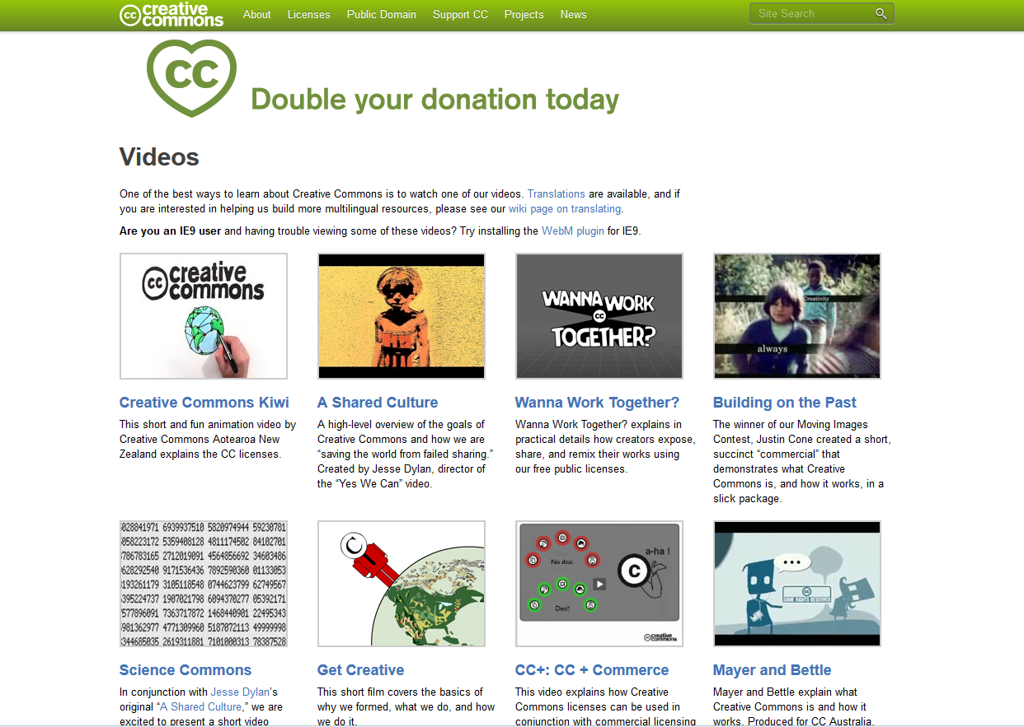
www.creativecommons.org

Slide 8
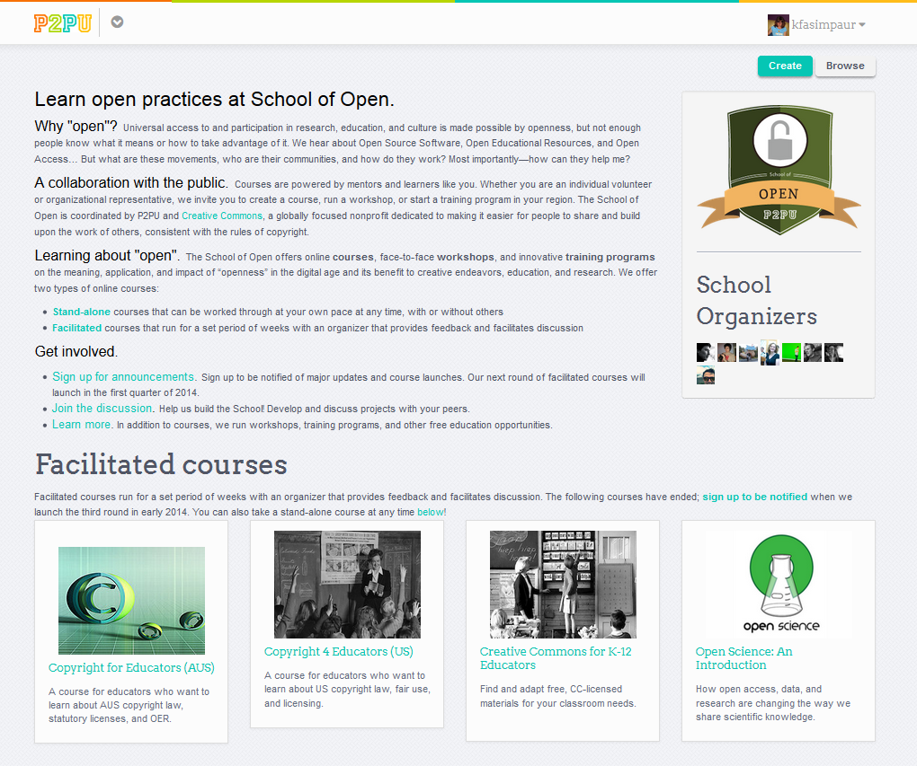
www.schoolofopen.org

Slide 9

March 10-15
Videos
Webinars
Project highlights
www. openeducationweek.org

Slide 10

OER Community of Practice
Coming soon!
www.k12opened.com

Slide 11
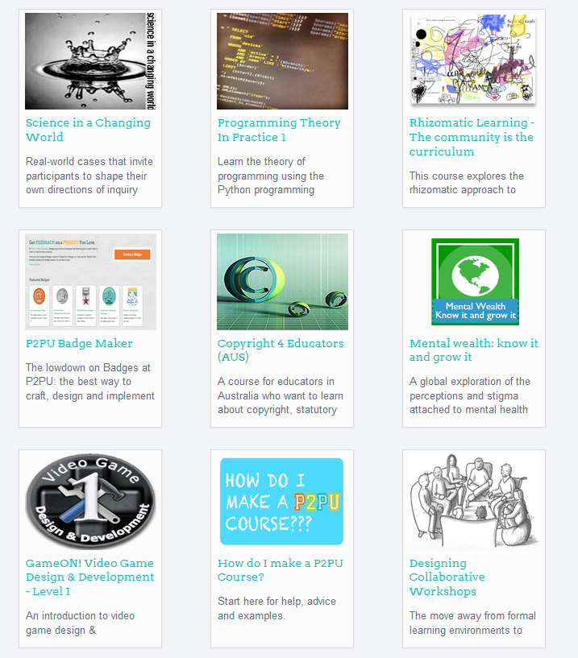

Open PD resources
www.p2pu.org

Slide 12


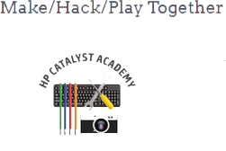


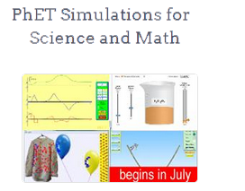
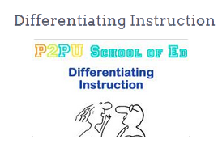

Slide 13
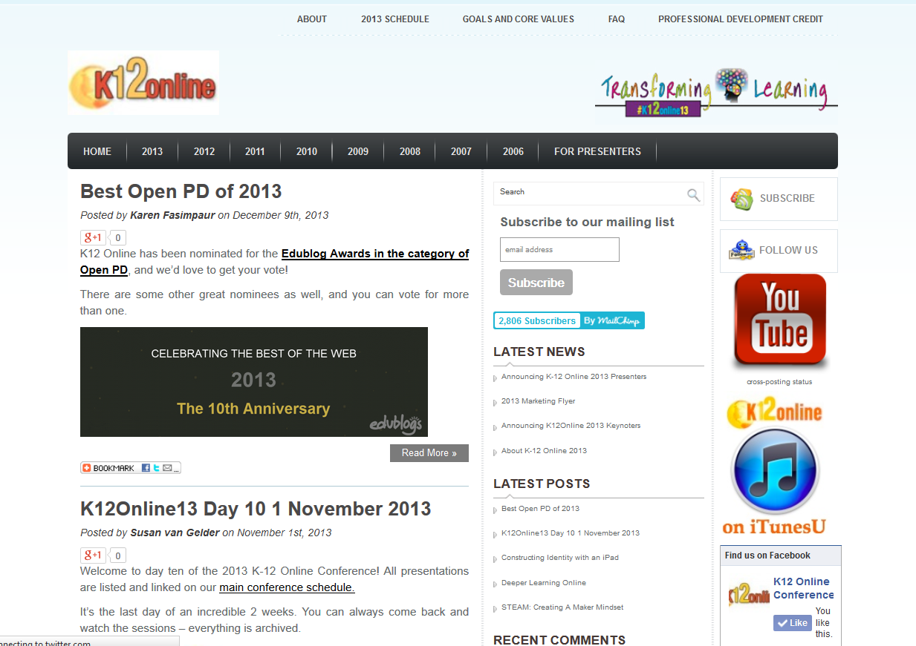
www.k12onlineconference.org

Slide 14
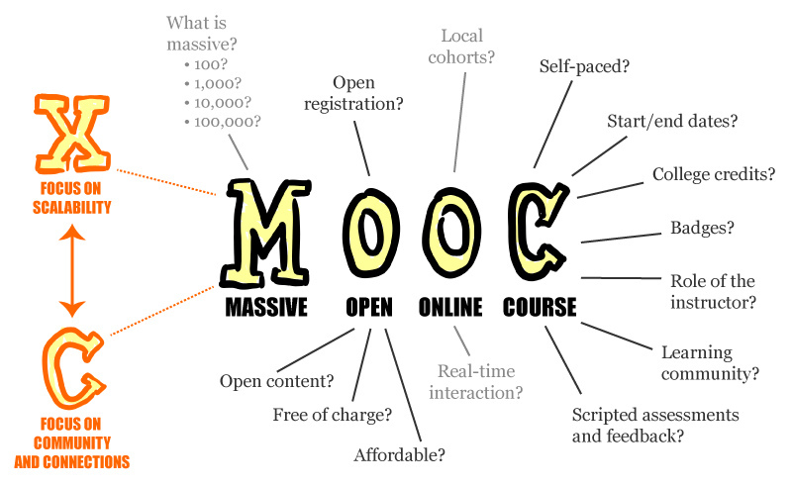
MOOCs
Image credit: Mathieu Plourde

Slide 15
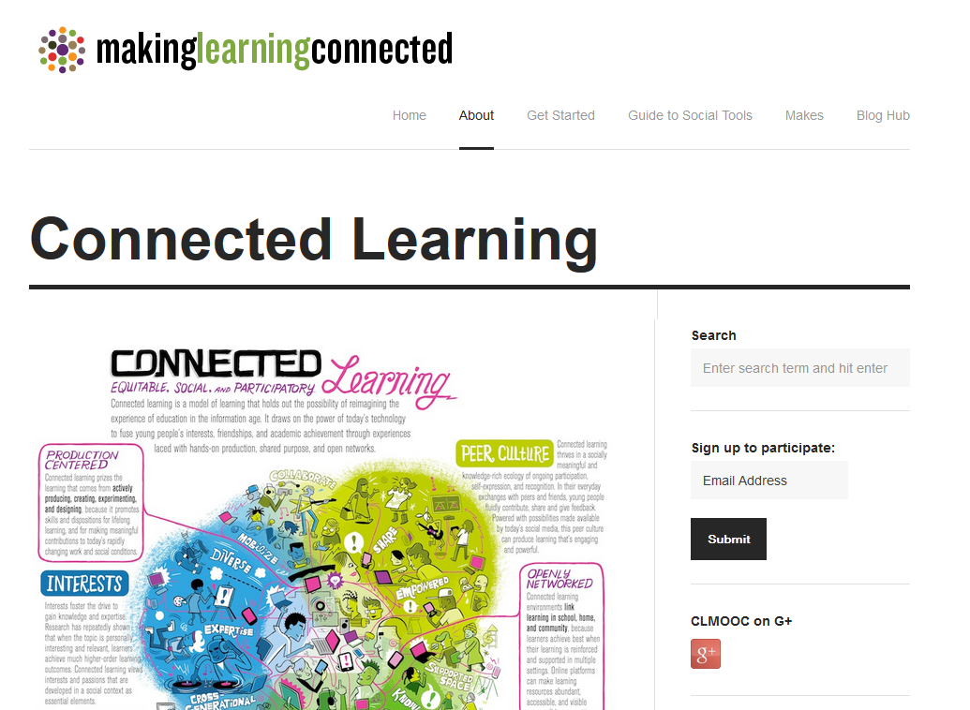
http://blog.nwp.org/clmooc/

Slide 16
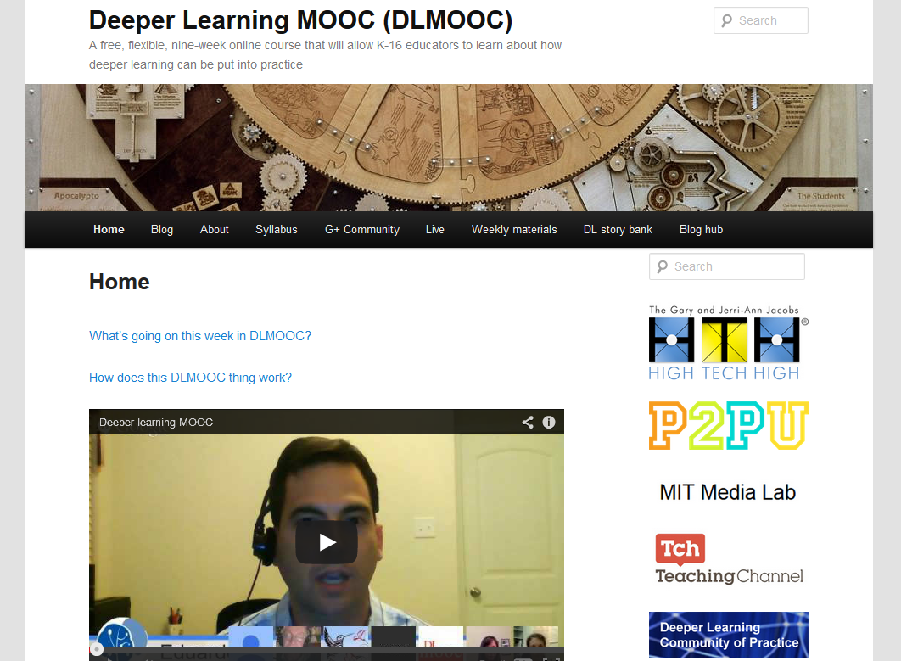
www.dlmooc.net

Slide 17









…and more

Slide 18
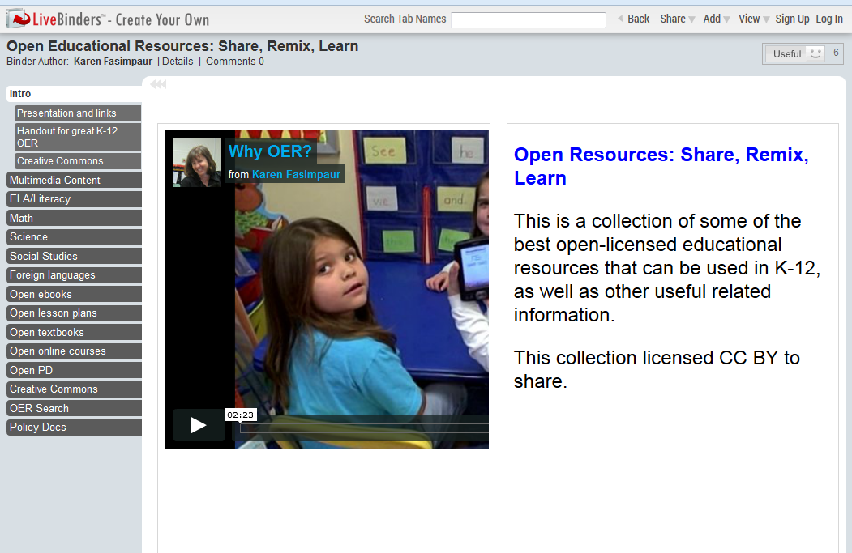
http://content.k12opened.com

Slide 19
Final thoughts
Q&A
Thanks for coming!
  Karen Fasimpaur
  karen@k12opened.com
  @kfasimpaur

