Slide 1

Common Core:
A Call for Innovation
Karen Fasimpaur

Slide 2
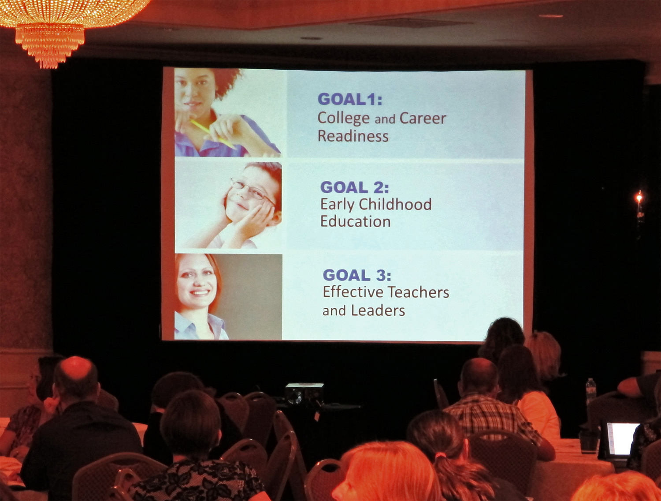
Credit: Cooperating School Districts of STL

Slide 3
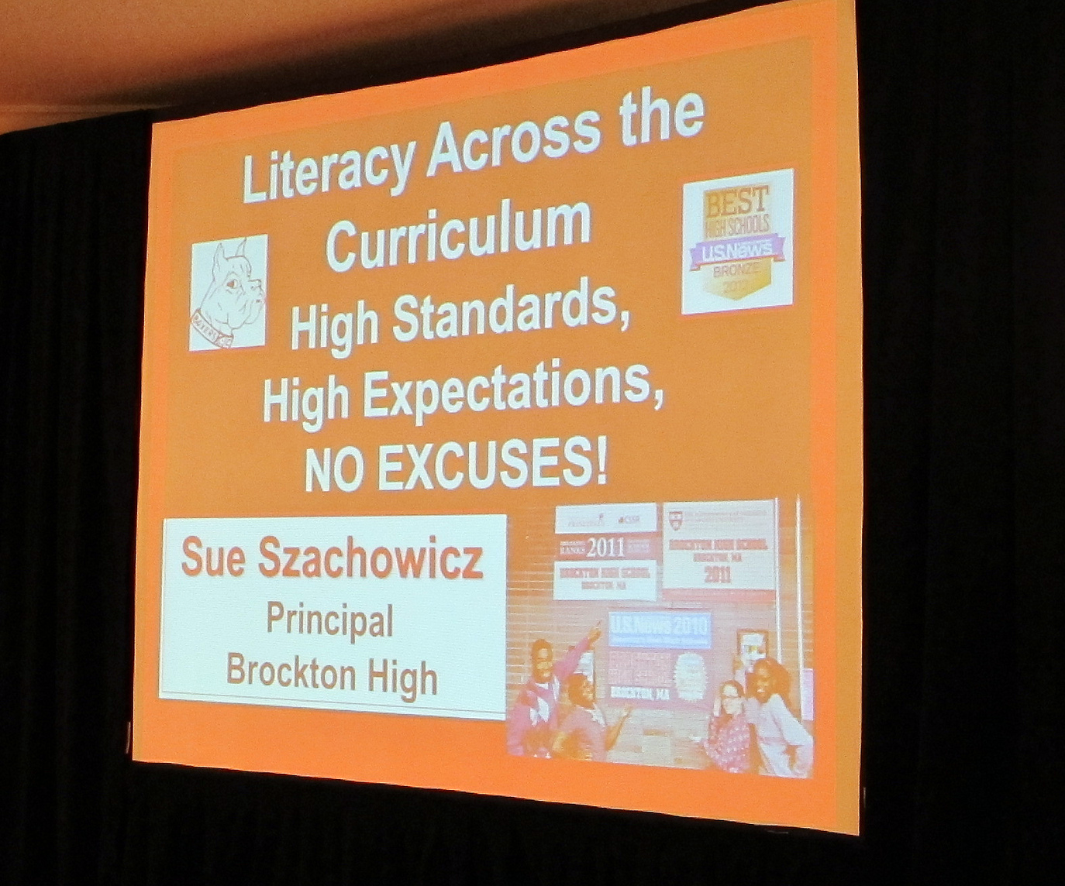
Credit: Cooperating School Districts of STL

Slide 4
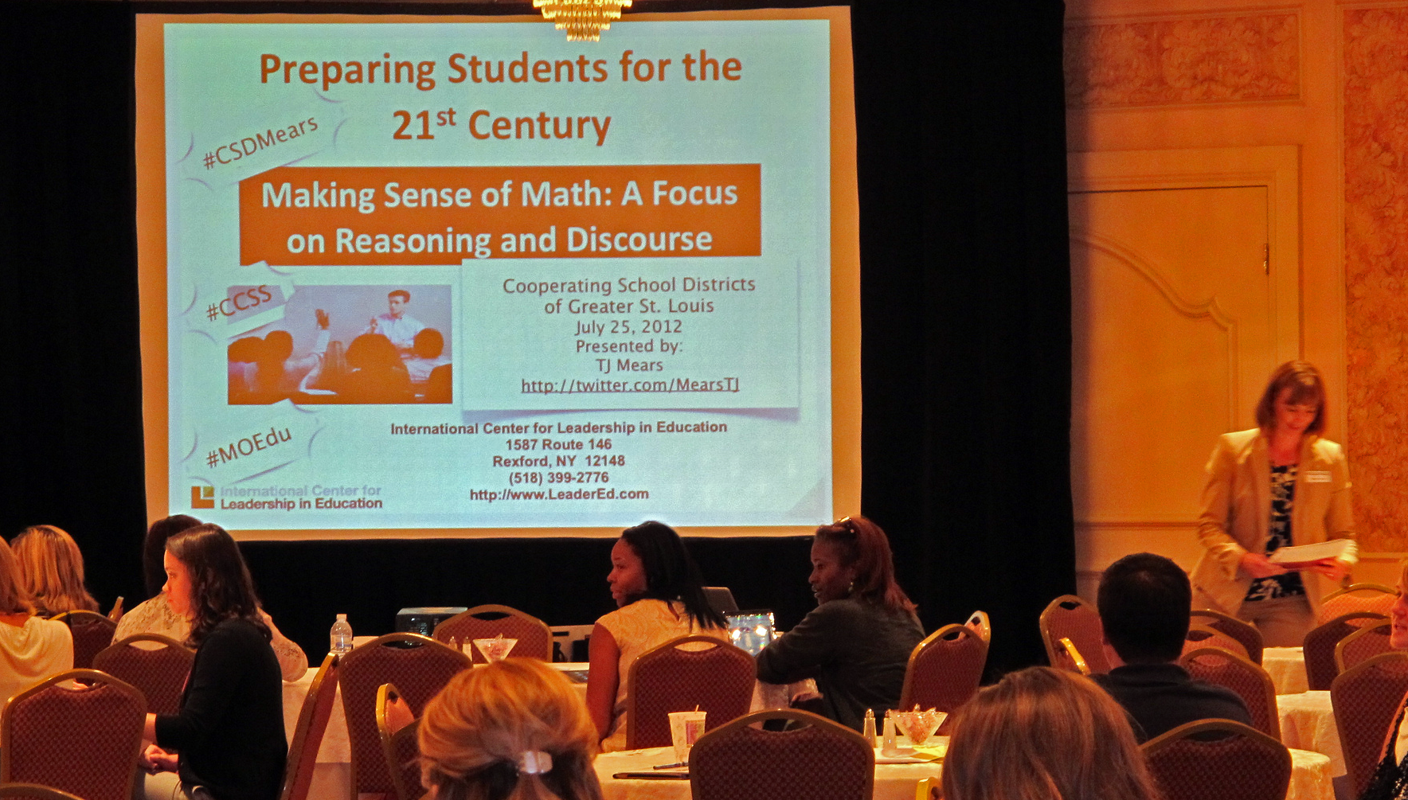
Credit: Cooperating School Districts of STL

Slide 5

Credit: albertogp123

Slide 6
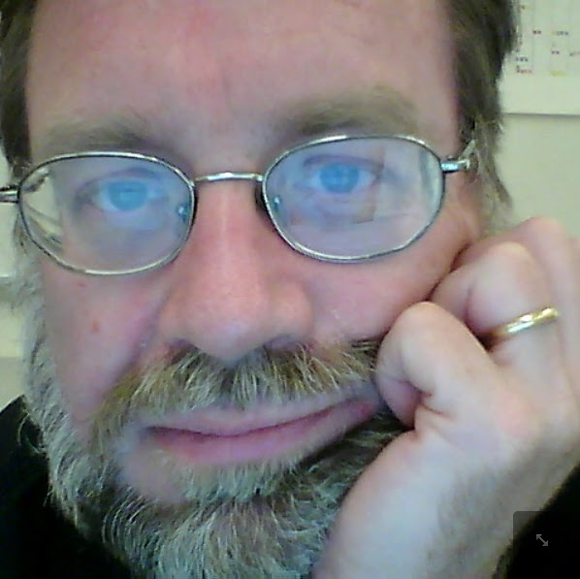
Paul Allison
Bronx Academy Senior High

Slide 7
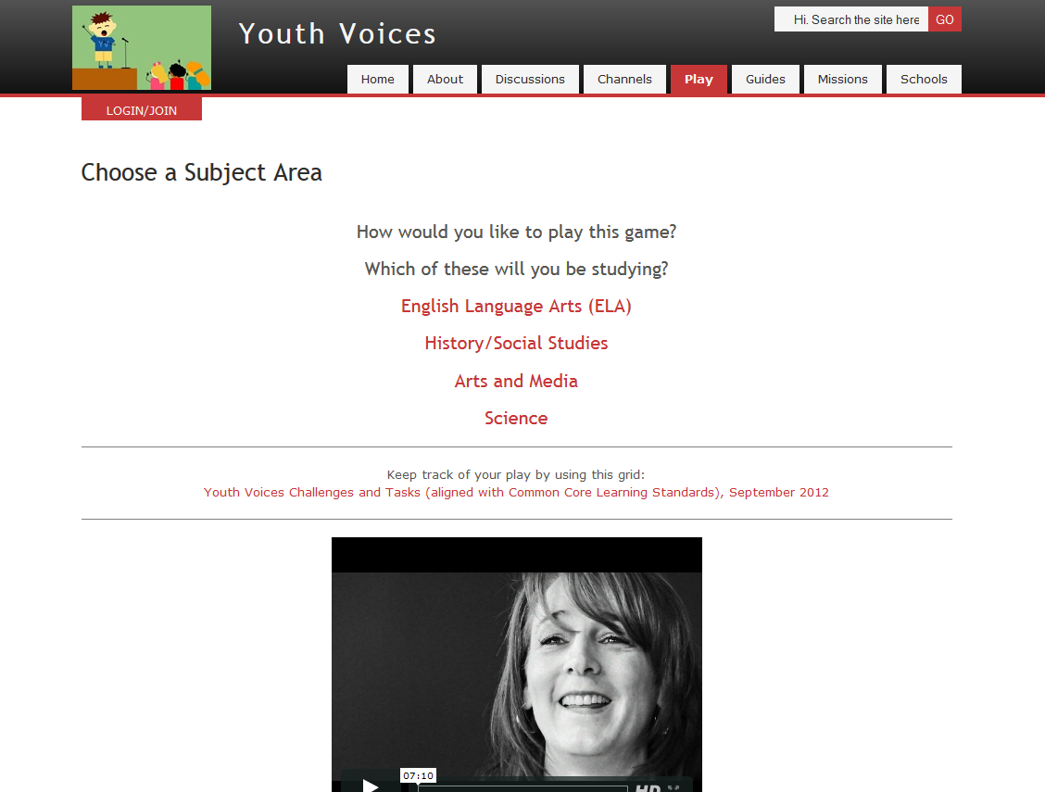

Slide 8
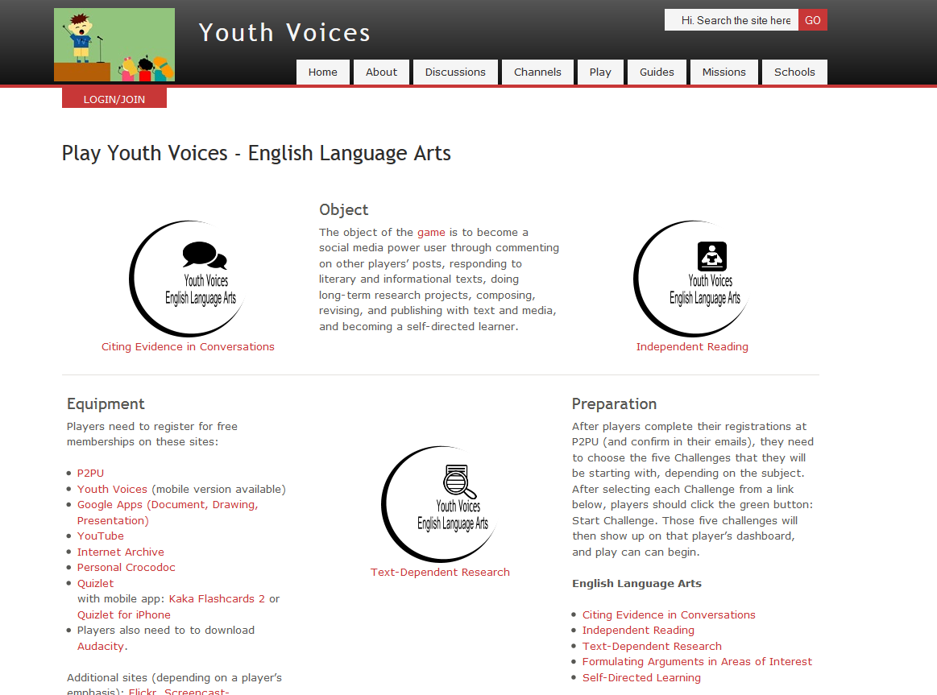

Slide 9
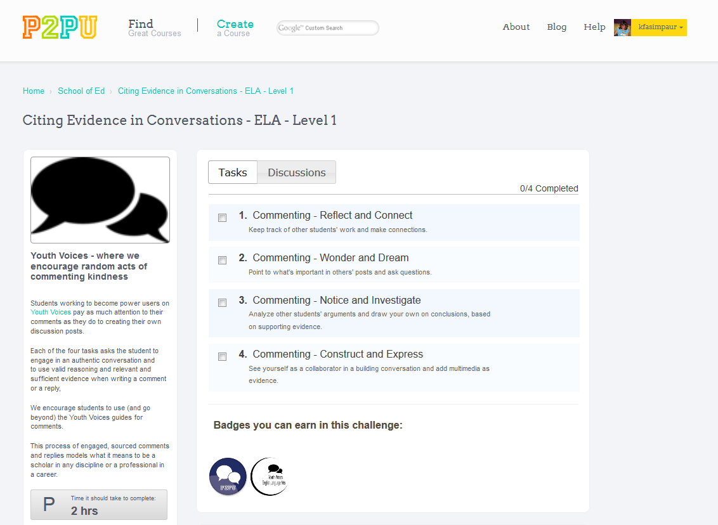

Slide 10
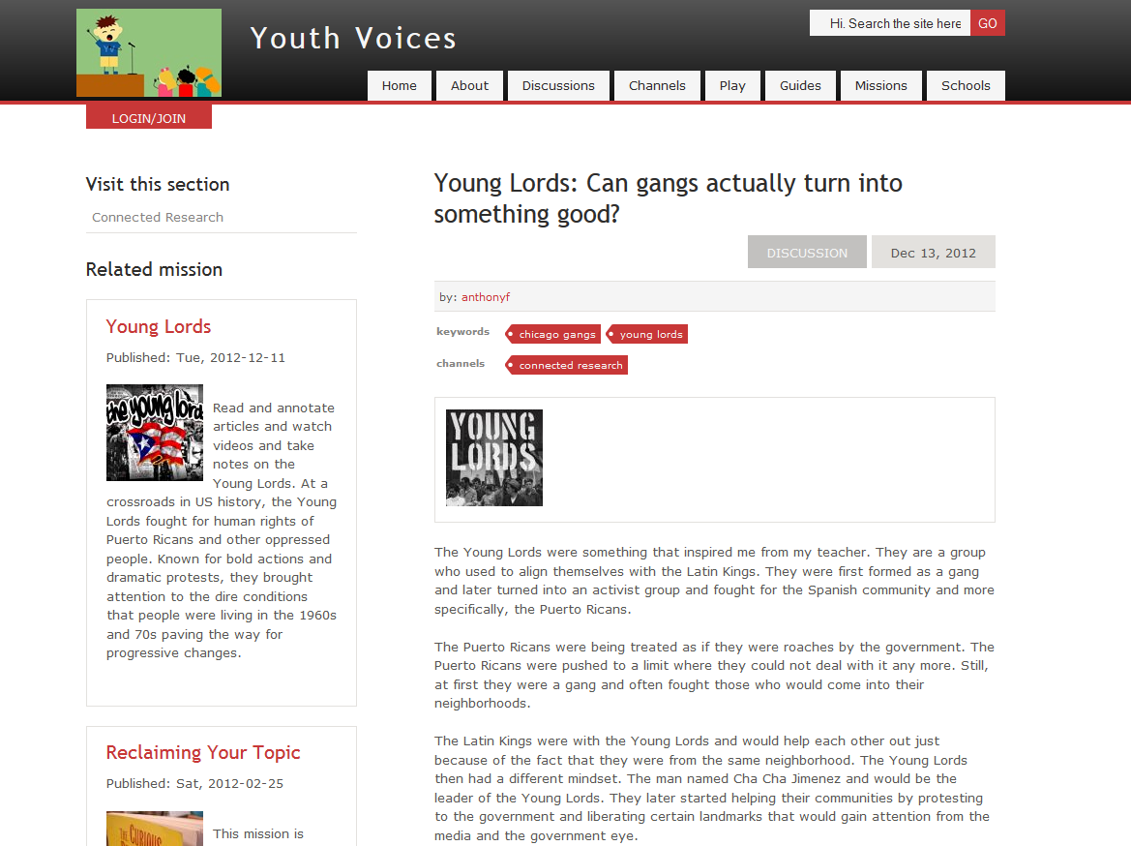

Slide 11

Credit: John Martinez Pavliga

Slide 12


Slide 13
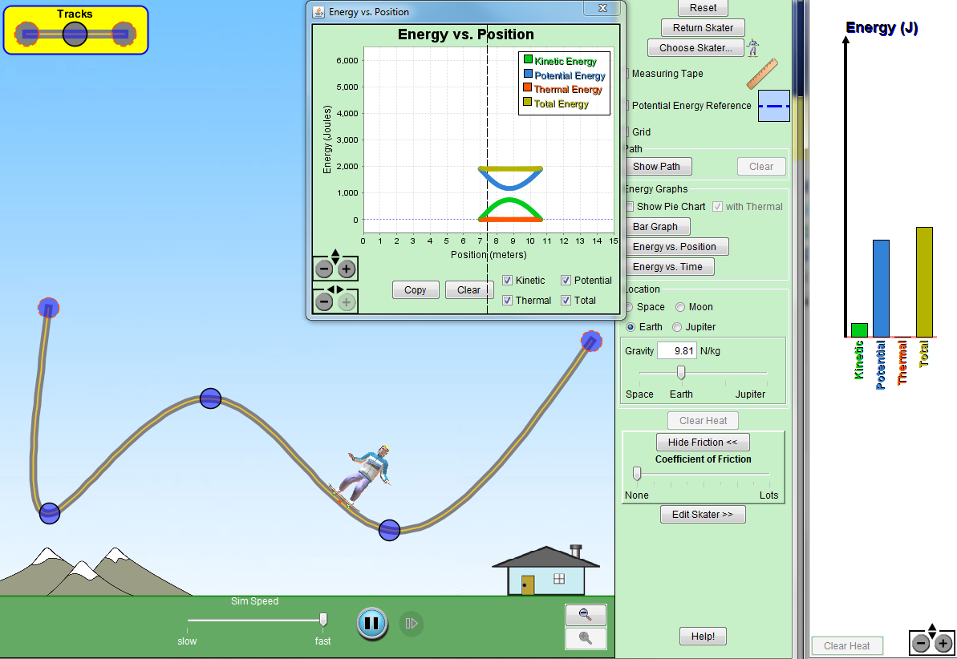
Credit: PhET

Slide 14
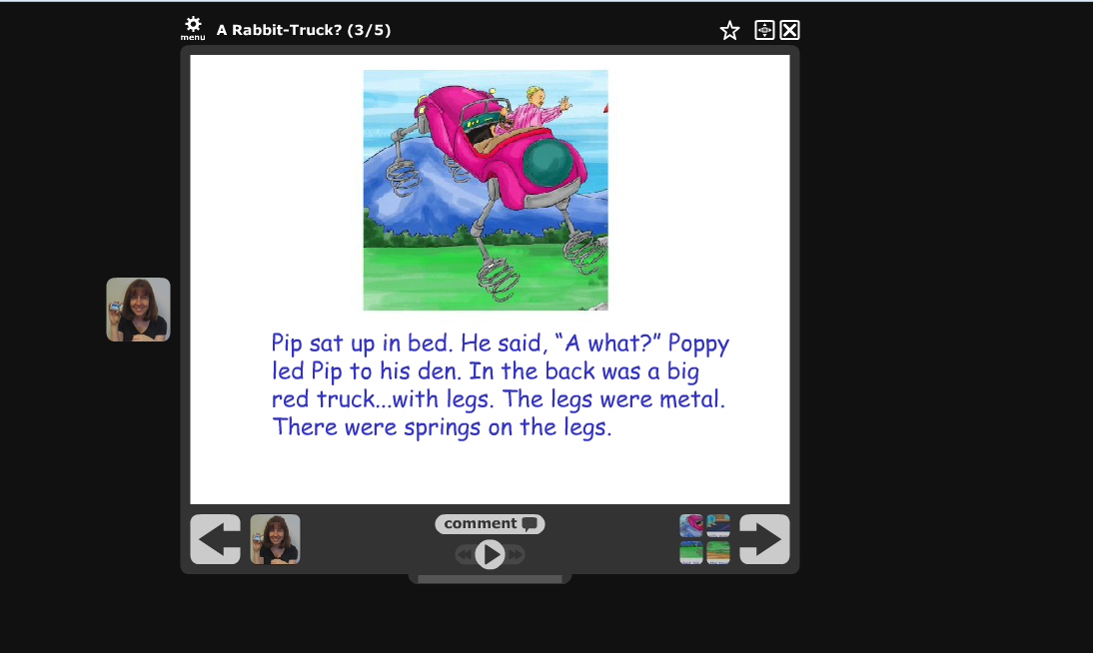
Credit: FreeReading and K12 Handhelds

Slide 15
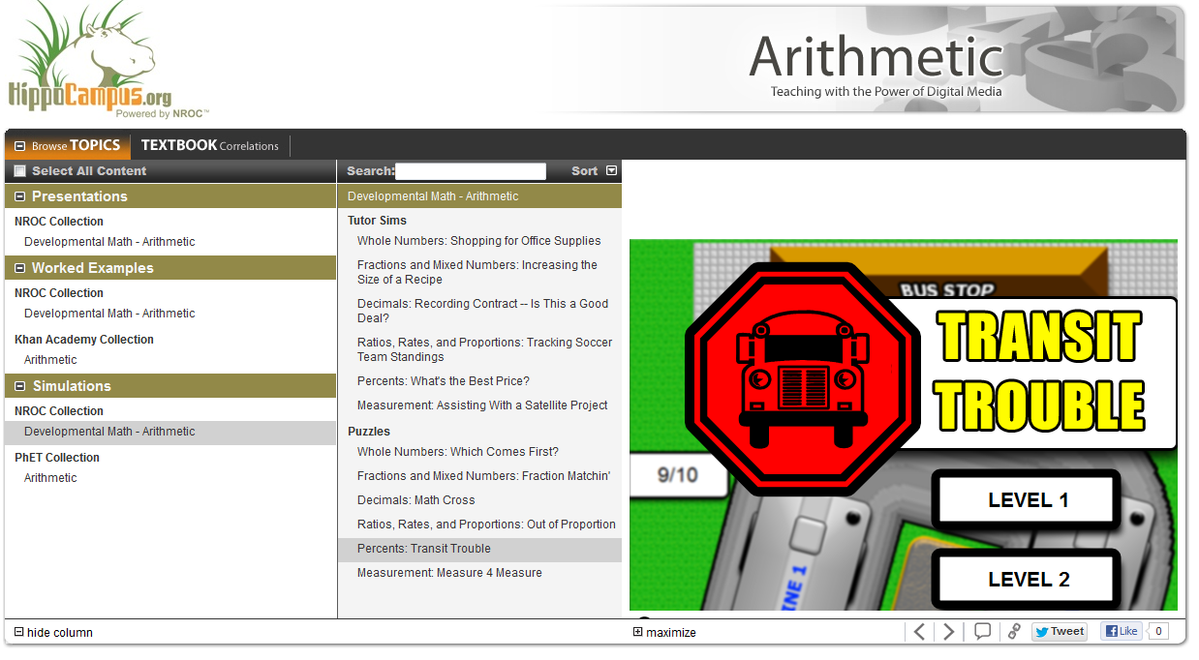
Credit: Monterey Institute for Technology and Education

Slide 16
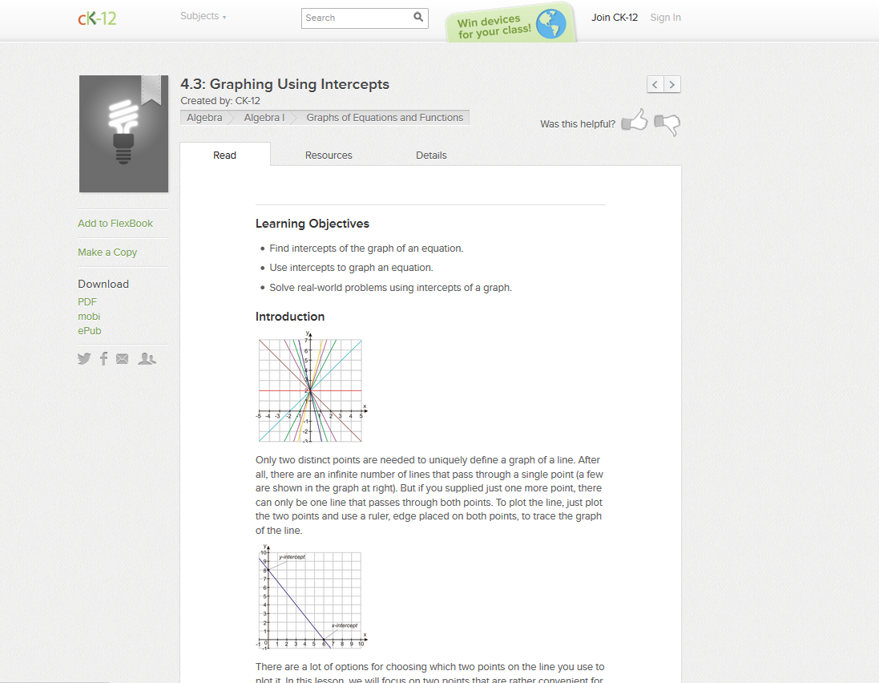
Credit: CK12

Slide 17
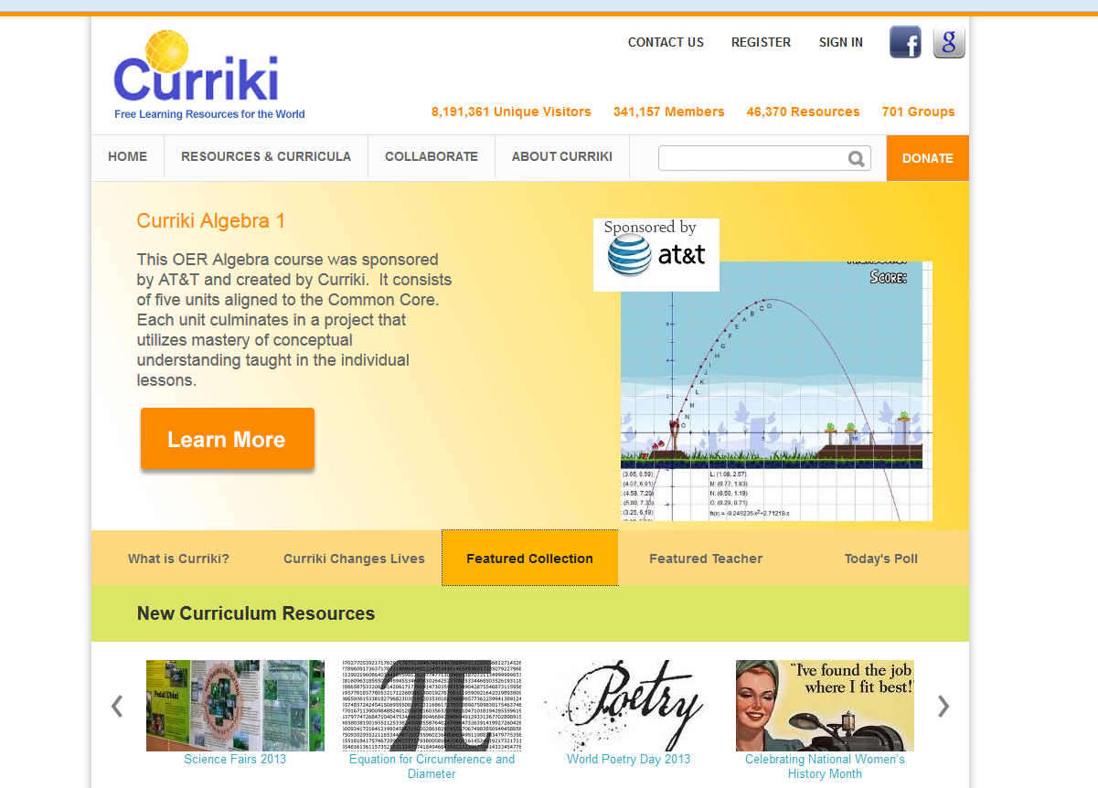

Slide 18


Slide 19
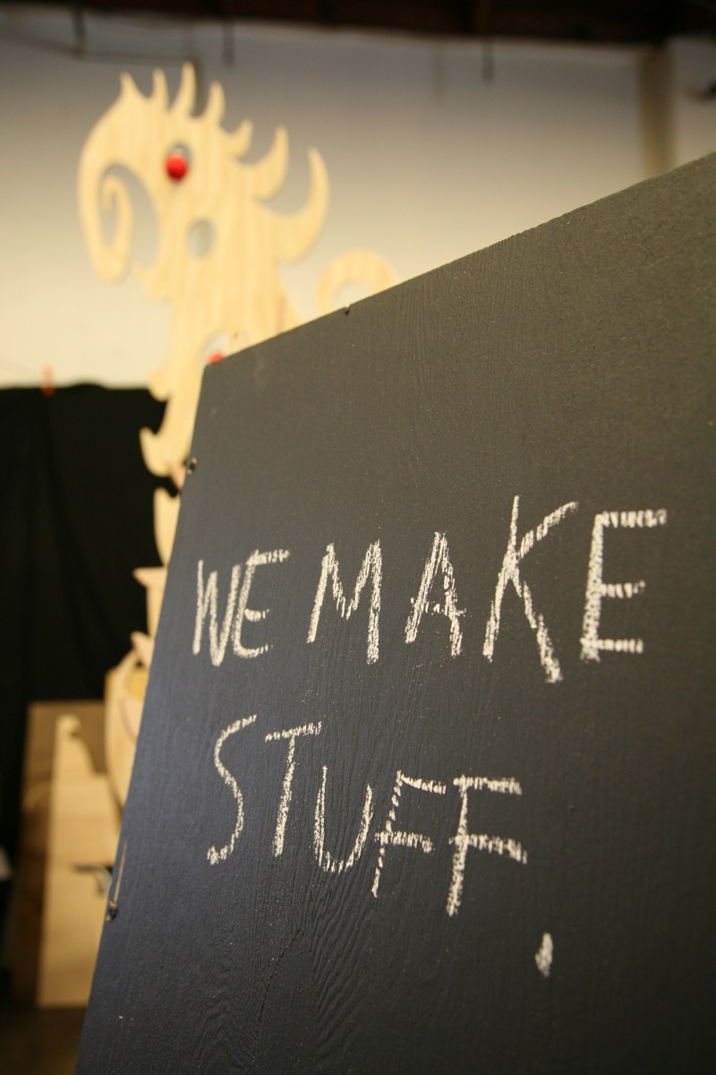
Credit: Scott Beale/Laughing Squid

Slide 20
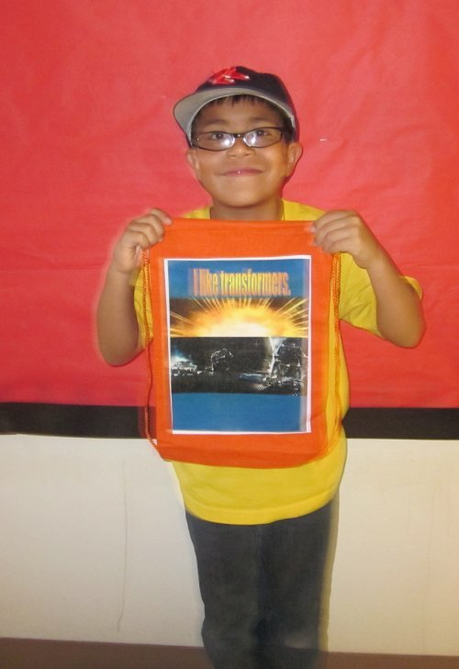
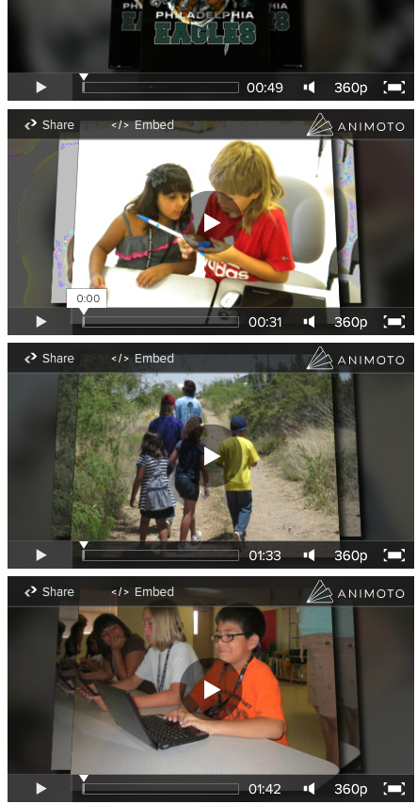
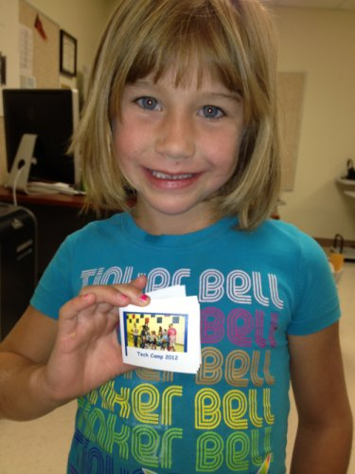
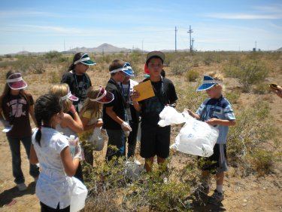

Slide 21
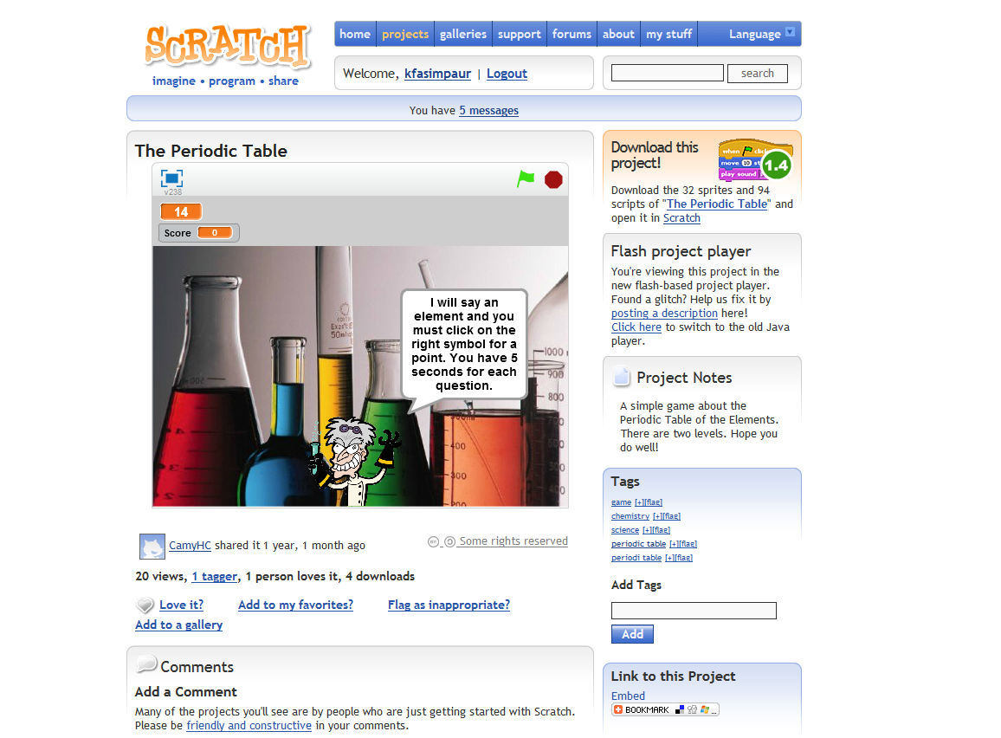

Slide 22
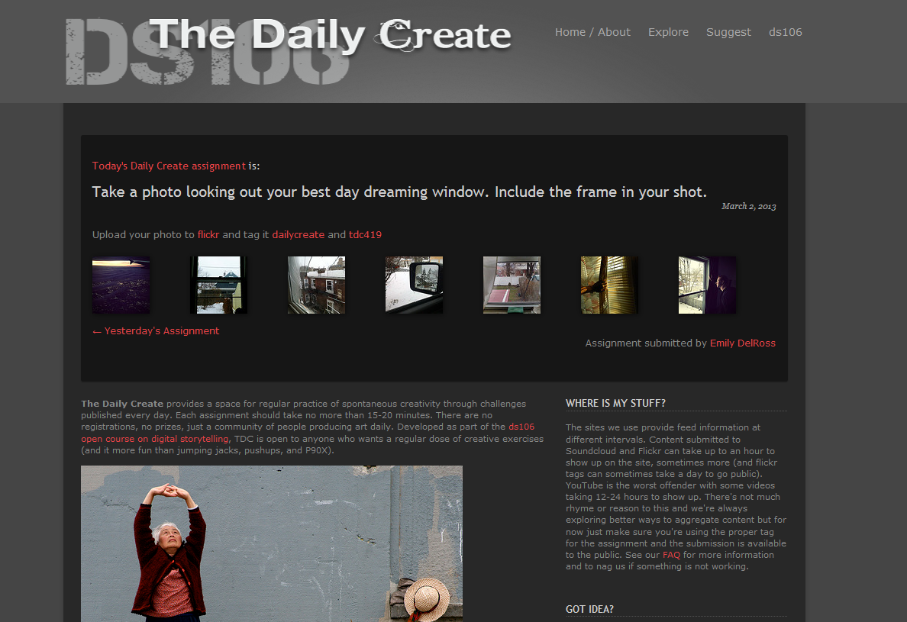

Slide 23
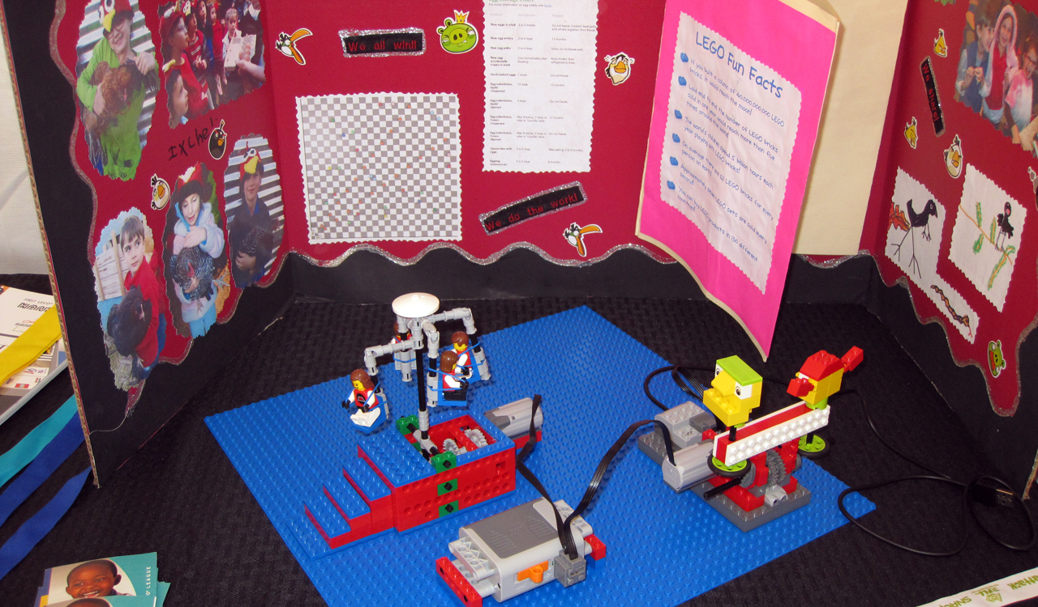

Slide 24
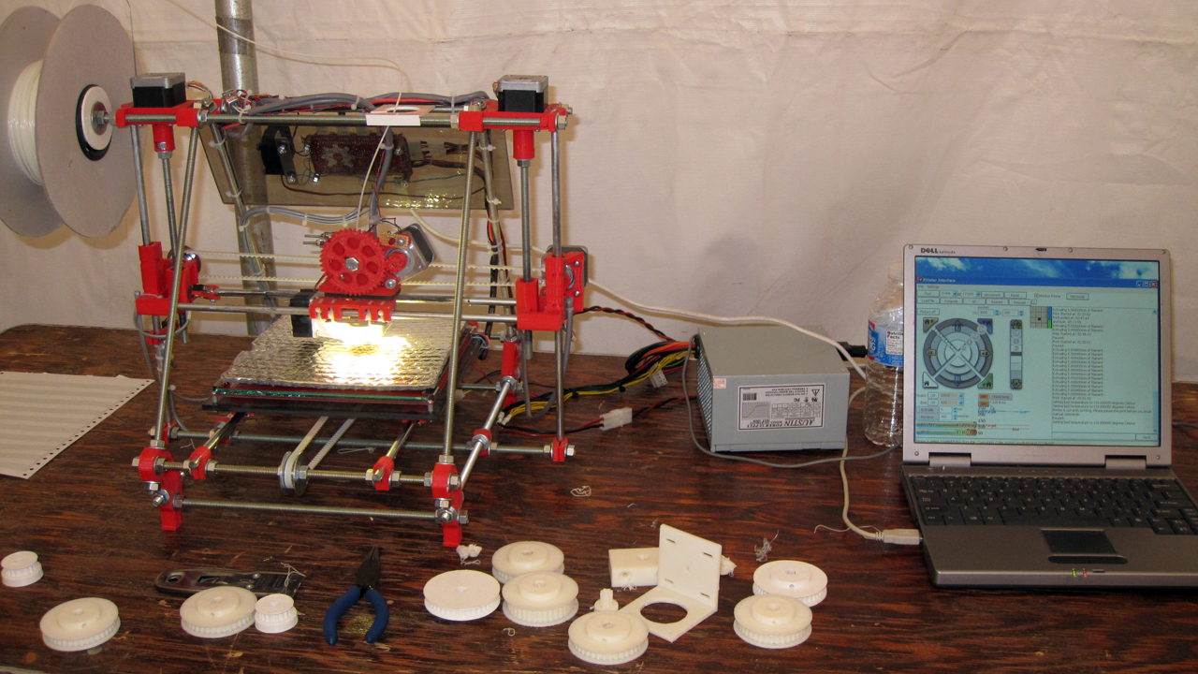

Slide 25
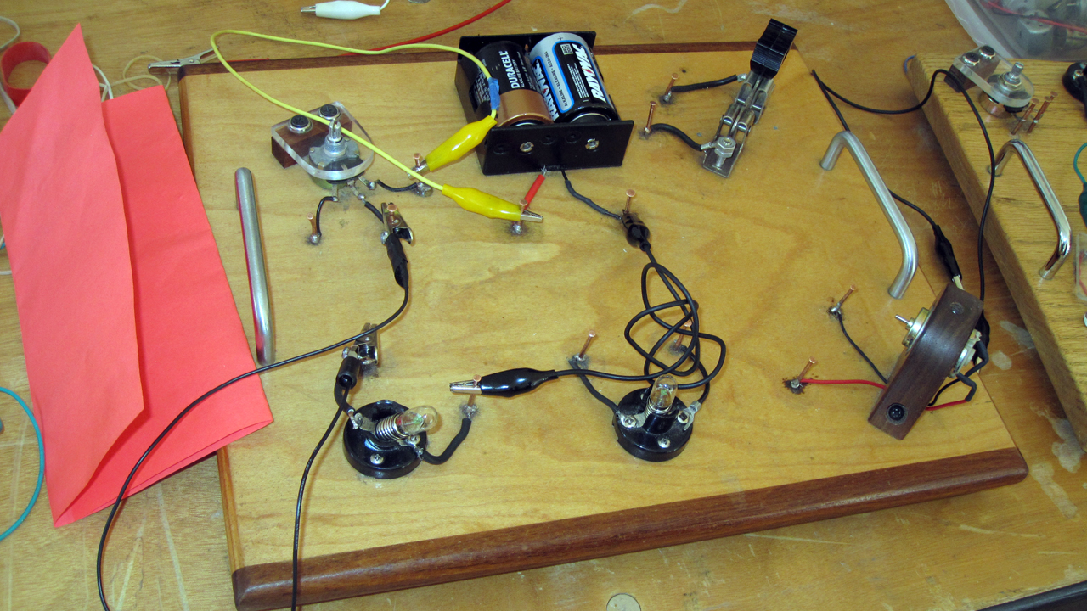

Slide 26
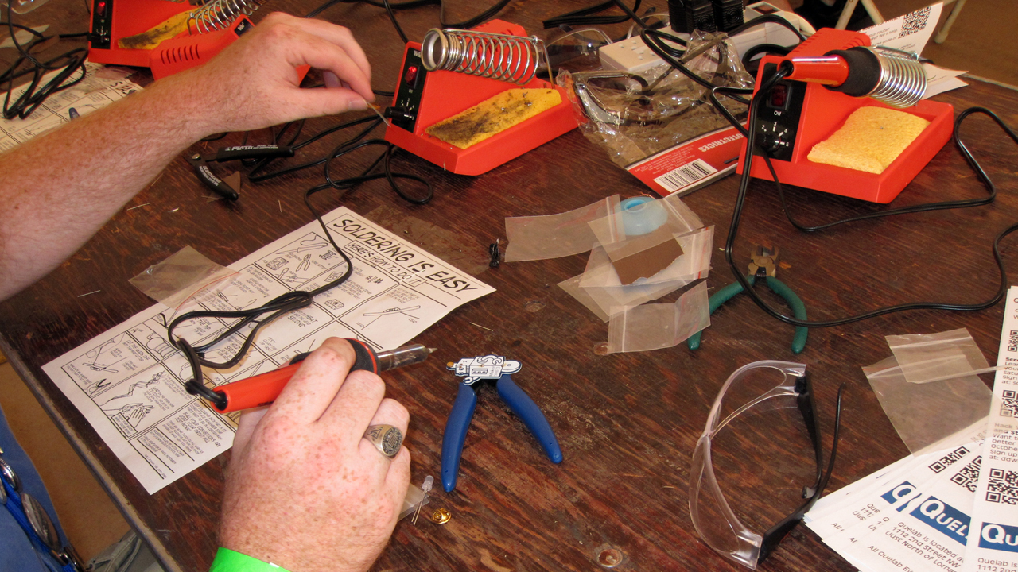

Slide 27
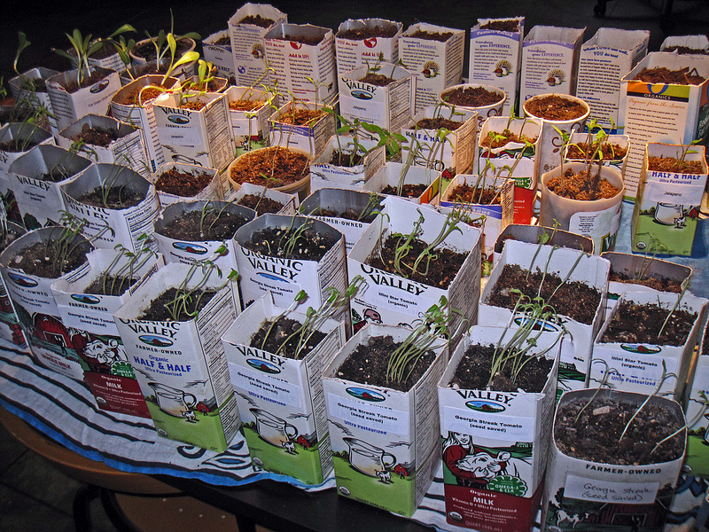

Slide 28
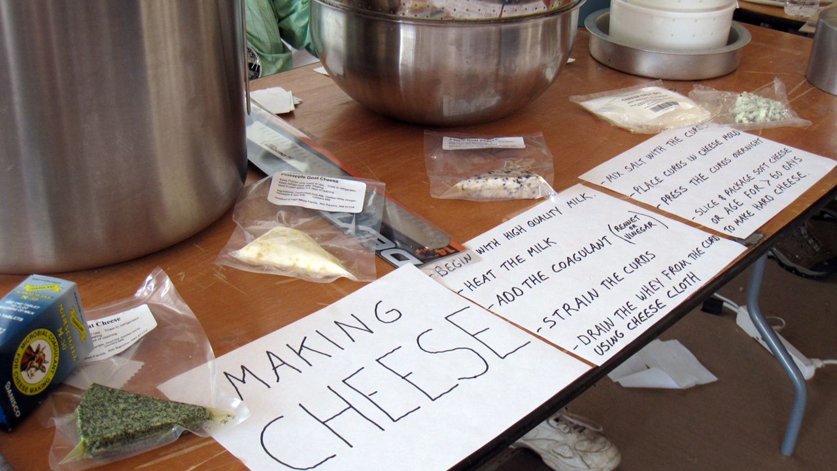

Slide 29
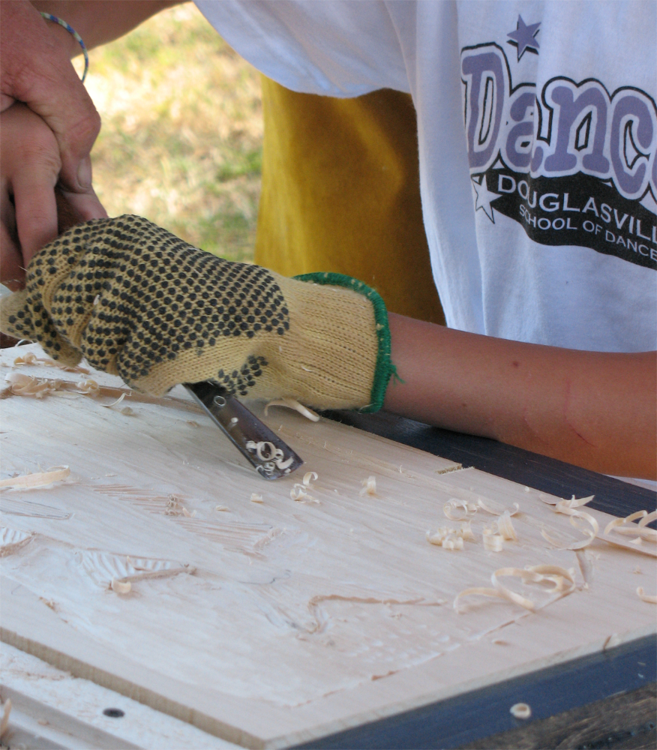
Credit: James Emery

Slide 30
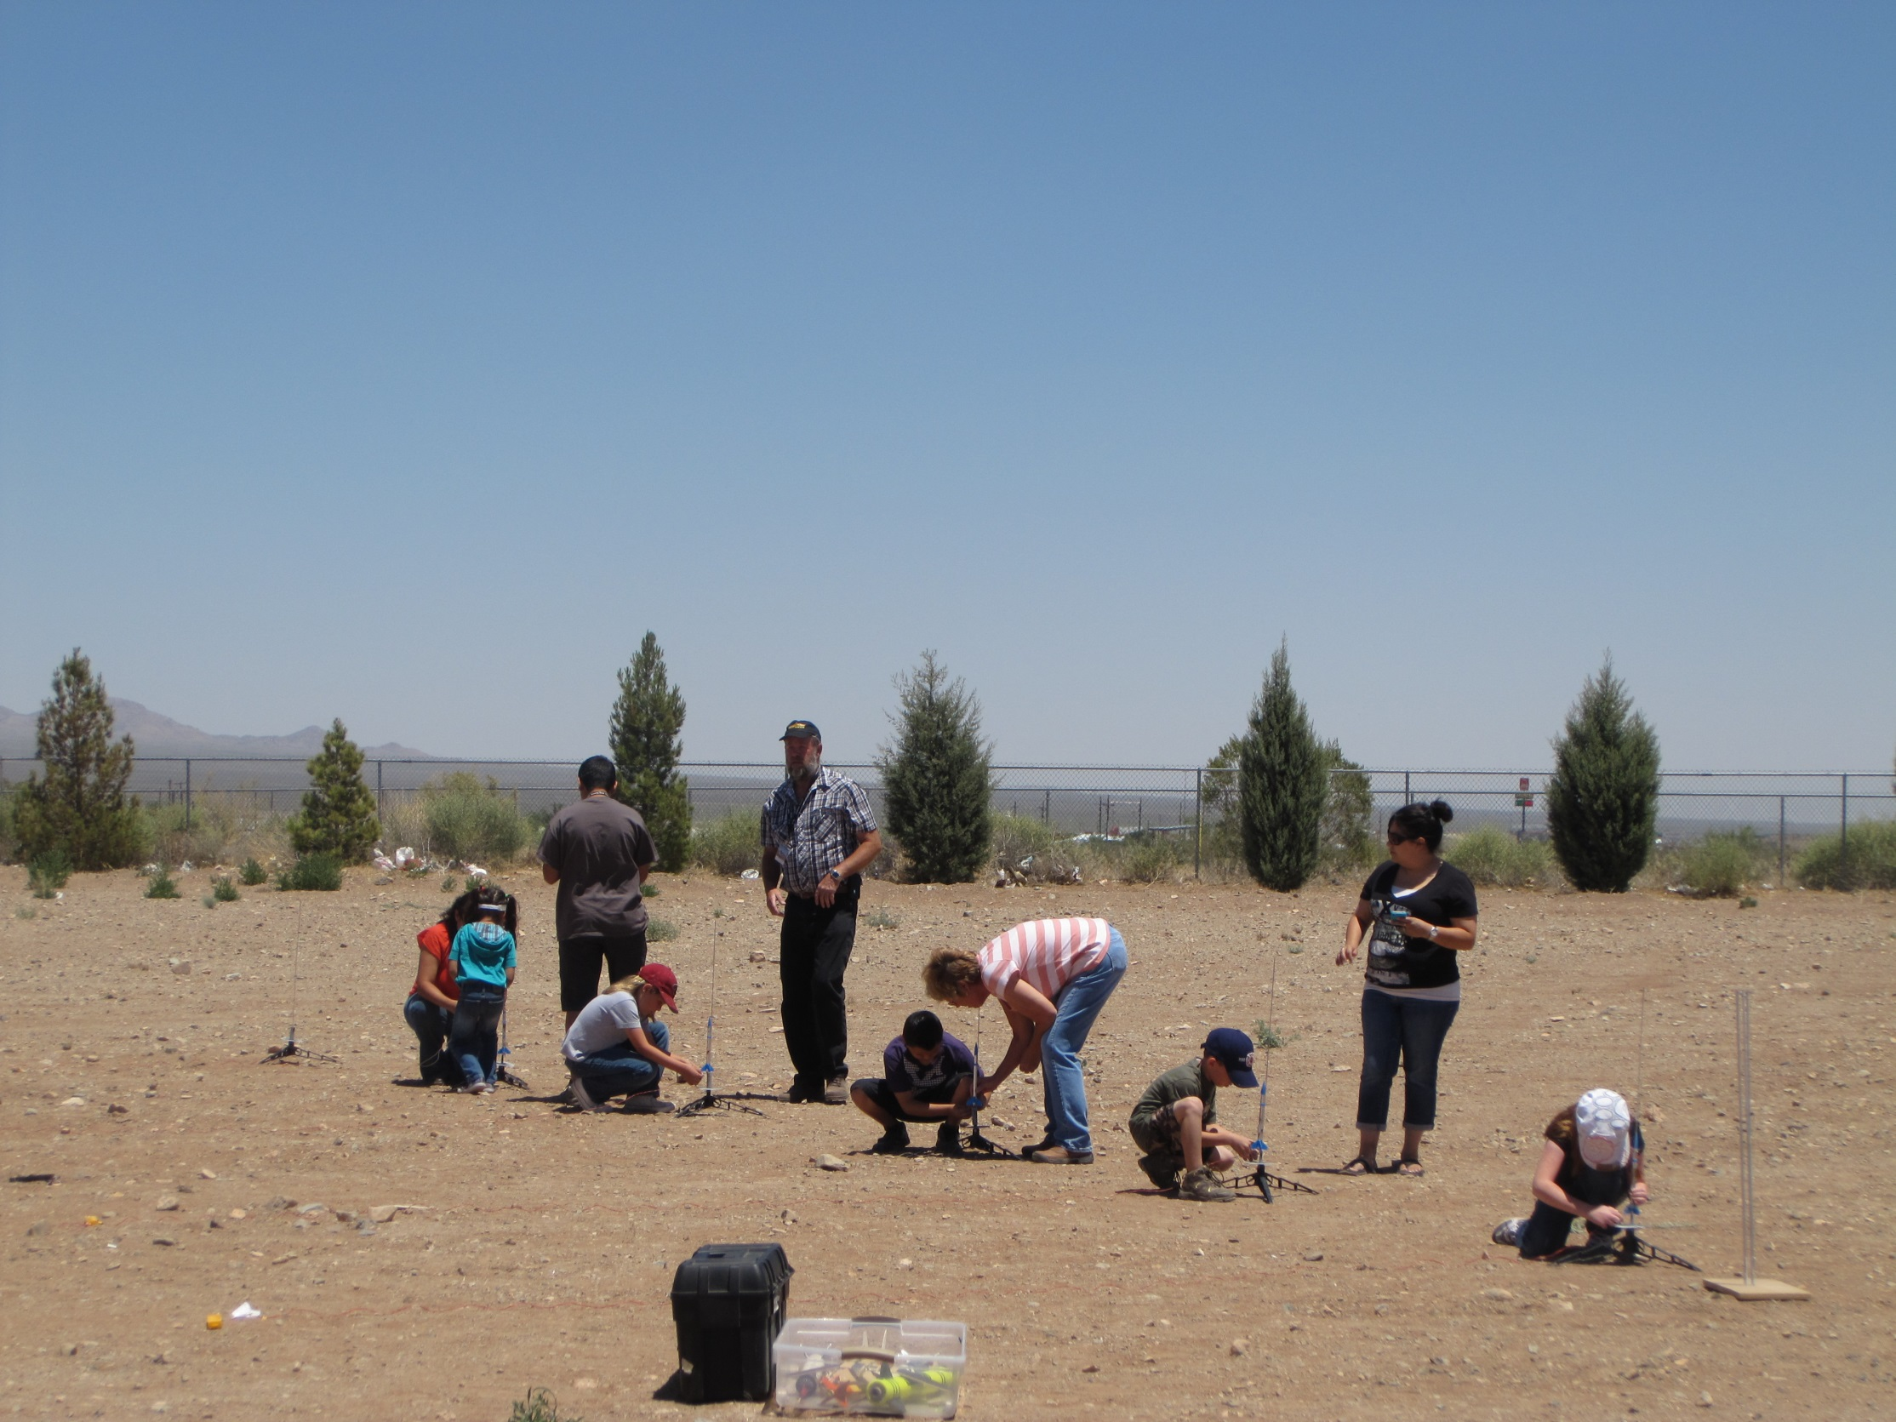

Slide 31
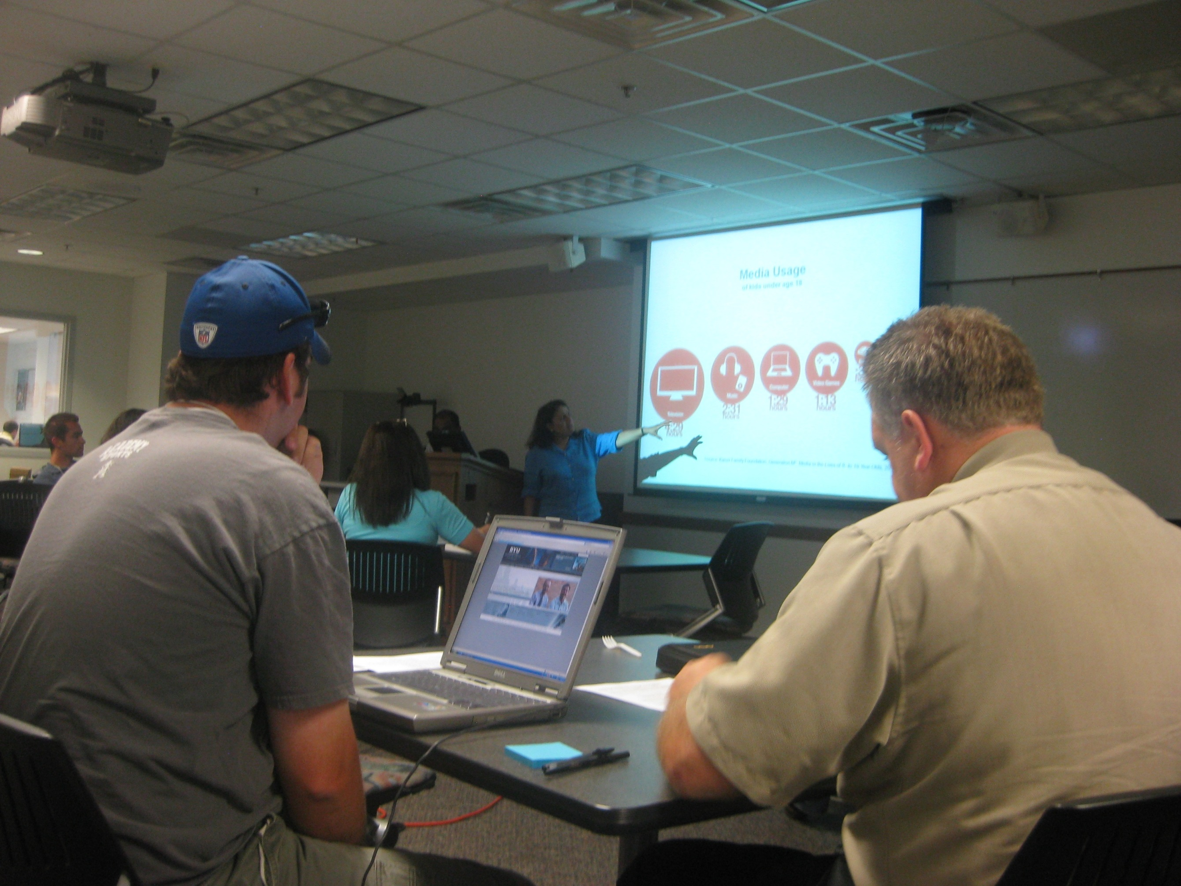
Credit: Utah Open Textbook Project

Slide 32

Credit: 401kcalculator.org

Slide 33
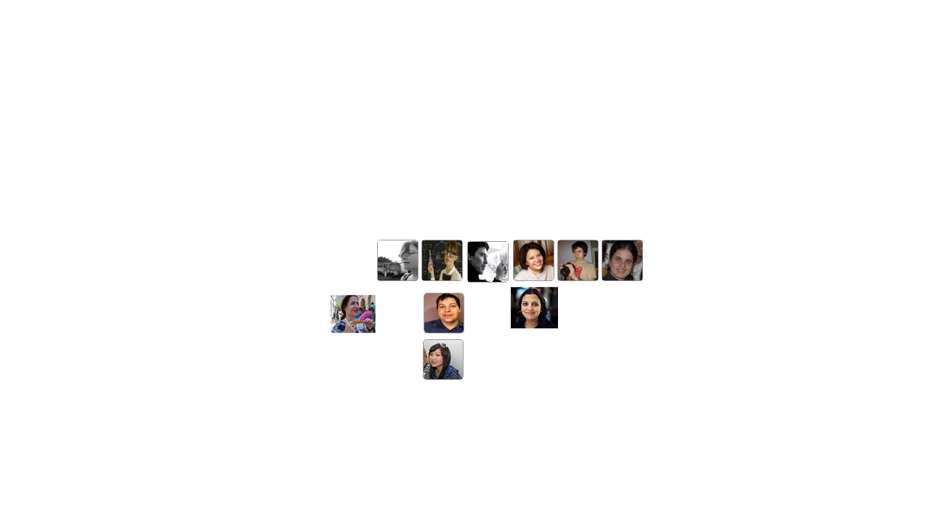

Slide 34


Slide 35


Slide 36


Slide 37
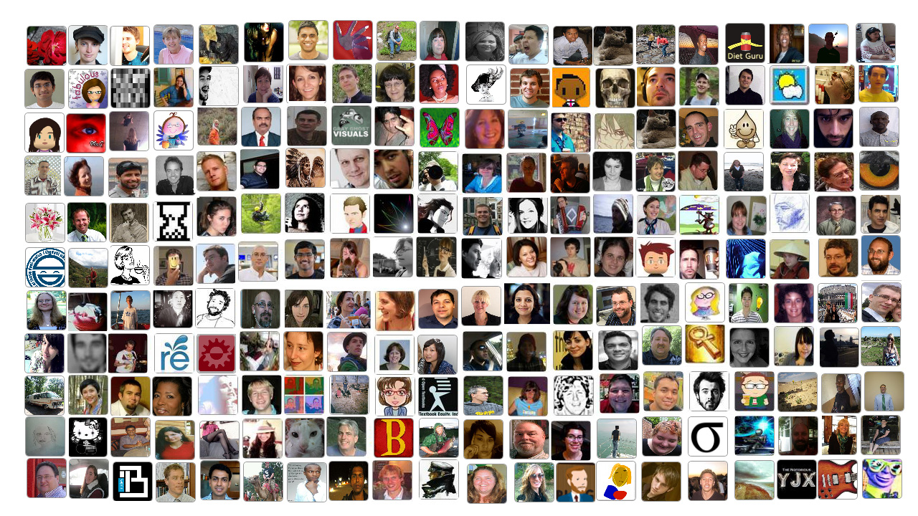

Slide 38
Let’s innovate together as a community!

